Slide 1
THE HIDDEN BEAUTY OF THE FOREST

Slide 2
What is a forest?
A forest is an area covered with complex vegetation typical of the geographical area concerned , these are trees growing in close quarters , with the animal world and the different elements of inanimate nature.

Slide 3
The Forest

Slide 4
Structure and characteristics of forests in Poland :
In Poland prevail coniferous forests , where the dominant species is Scots pine (which constitutes 69.4 % of all forests ) . The huge advantage of pine trees in national forests stand is the result of high resistance, small requirements of the soil, climatic conditions, and large-scale afforestation in the genre. The average age of the trees is 50 years. Forests in Poland cover about 28.3 % of the total area of ​​the country . In our country there were left little of the original plant communities. Primary complexes of the primeval forests have survived in fragments , mainly in the Bialowieza Forest. Most of the forests are young and susceptible to diseases. The negative impact on the state is caused by industrial pollution . Particularly sensitive to dust, gases and acid rain are conifers . Forests are destroyed by fires and also unsustainable forest management .

Slide 5
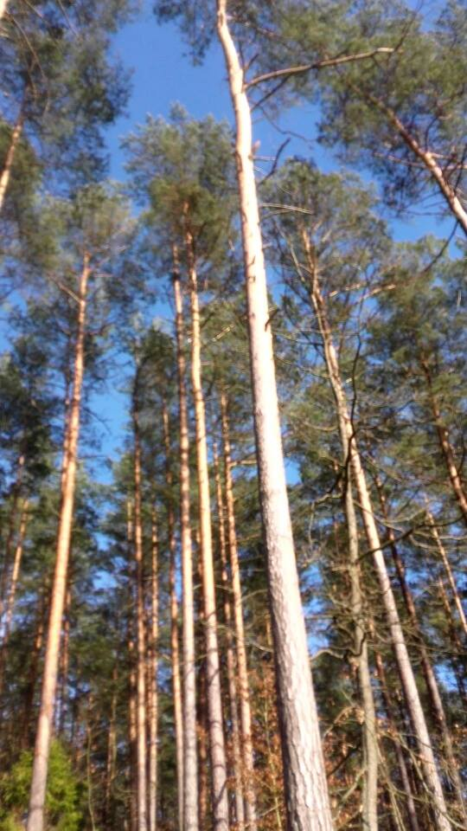
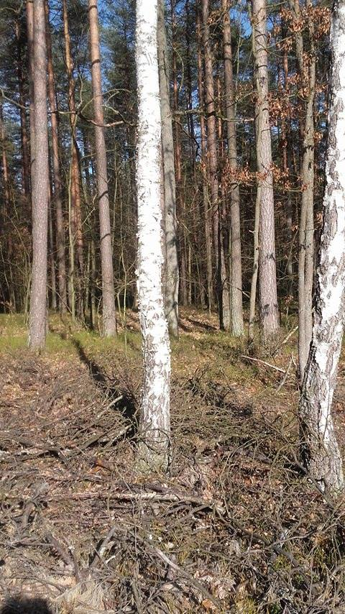

Slide 6
The smallest things are always the most beautiful

Slide 7
The most beautiful creatures of the forest

Slide 8
Flowers in the forest

Slide 11
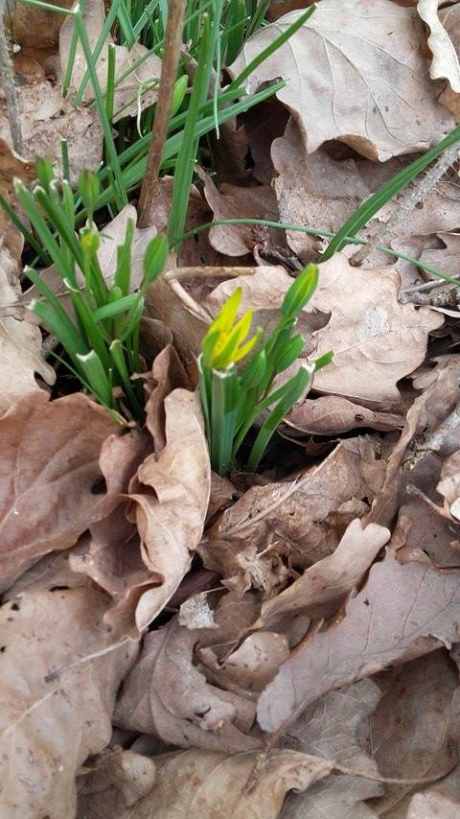

Slide 12
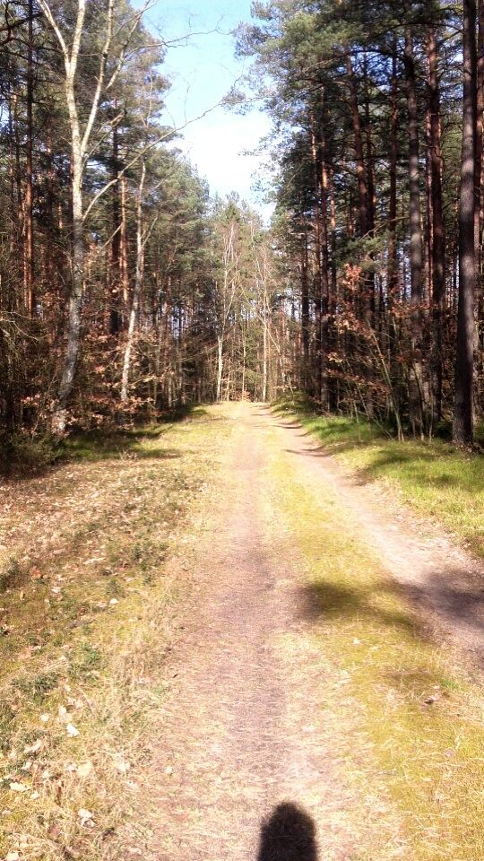
Charm of the forest

Slide 13
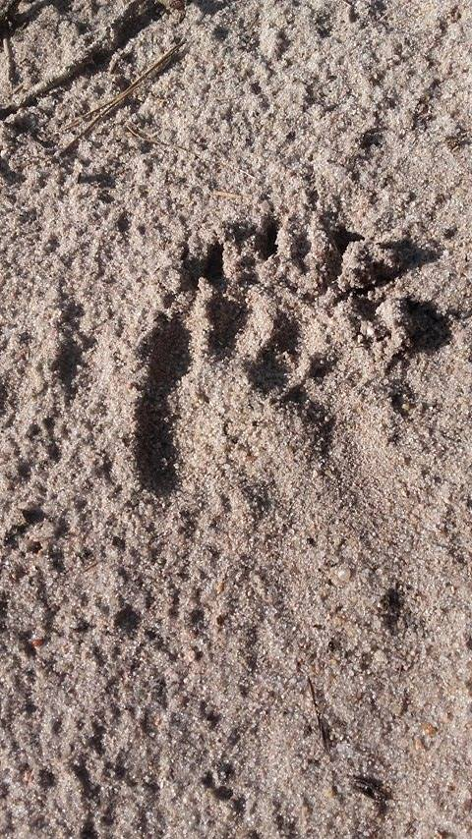
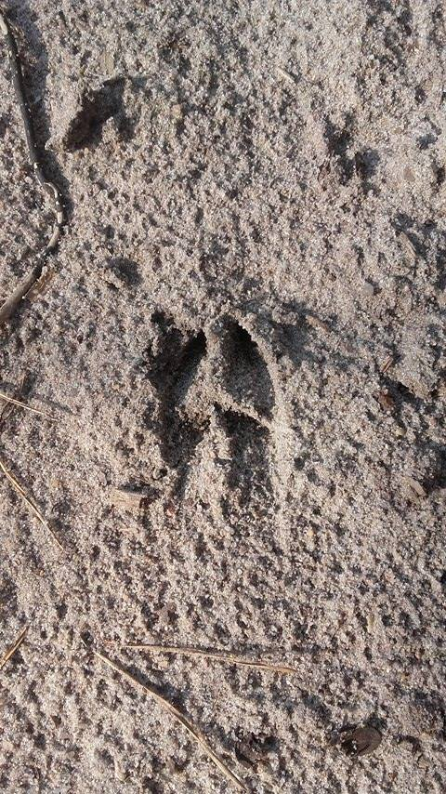
Traces of animals

Slide 14
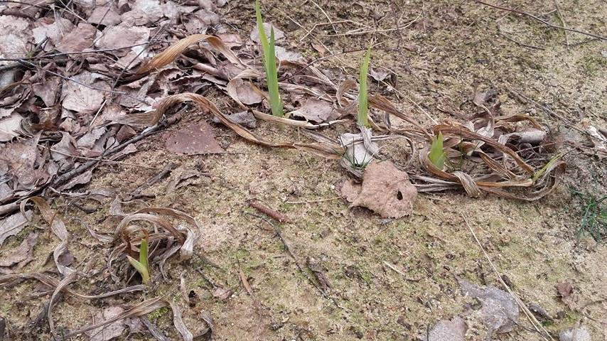
Prepared by:
Adrianna Rekowska, klasa III gimnazjum
Barbara Wróblewska , klasa III gimnazjum
Radosław Milewski , klasa III gimnazjum

